Slide 1




Not All Claims are Created Equal: Choosing the Right Statistical Approach to Assess Hypotheses
ACL 2020
Erfan Sadeqi-Azer (Indiana U → Google) Ashish Sabharwal (AI2) Dan Roth (UPenn).
Notes:
Hello everybody!

Slide 2
About me
Join in 2013
Graduated in early 2019
Now: AI2, Seattle
Notes:
For new members of Dan's group that might not know me:
I joined Dan's group in 2013, when we were still in Illinois
I graduated in early 2019, after 6 years of hard work
and now you I work at Allen Institute for AI in Seattle.
The picture here shows us on our graduation day.
I am the one on the right side,
next me, it is Stephen
then Dan
and finally Shyam.
And right behind us we have Doctor Ben Franklin, a founding founder and the founder of UPenn

Slide 3
This talk
Hypothesis testing/assessment:
A topic we’re [kind of] familiar with, by virtue of working in an empirical field.
There are holes in our understanding of these concepts and their usage.
Mix of new ideas and known stuff.
Notes:
This talk is going to be about hypothesis test/assessment /
- .... This talk is a tutorialized version of a recent paper we have published.
- Not only this is meant to be a tutorial for those who are not familiar with the subject,
- I promise to show you some new intuitions, for those who're already familiar.

Slide 4
The Cycle of Empirical Research
Hypothesis, or a General Premise
????
Research
Problem
Assessment/
Verification
Empirical Observations
Notes:
Let's start by talking about a typical empirical research.
The beginning of the cycle starts with curious lab experiments and empirical observation.
The observations result in research problem Questions about: what, or why something is happening.
Based on the observations we form “hypotheses” that could explain our intuition
And finally, the step where we assess our hypothesis.
Here is the focus of this work. We study different hypotheses, the question they address and their assessment.

Slide 5
Hypotheses
A prediction about how the world will behave if our idea is correct
Worded as an if-then statement
A hypothesis is a testable prediction
A hypothesis is a falsifiable statement
Terminology:
A hypothesis is never “proved”
But it could be “supported” by the evidence
Notes:
Let's try to define "hypothesis" since it's gonna come up many times throughout this presentation.
A hypothesis is a prediction about how the world will behave if our idea is correct, and it is often worded as an if-then statement
A hypothesis should be testable
A scientific hypothesis is also falsifiable, or capable of being shown to be incorrect.
A small but important point about word choice:
A hypothesis is never “proved”, and it is better practice to use the terms “supported” :evidence could support a hypothesis.

Slide 6
Not a good statistical hypothesis
2020
2020
<
?
Notes:
Let's see an example of a bad hypothesis. Here is one example:
The USA do better off with a Biden administration, not a Trump administration.
This actually is not a good hypothesis; why not?
You might say, of it's course! Okay, fair point, but that's not the reason.
There is no data to test, and therefore, it is neither testable nor falsifiable.

Slide 7
“I can always prepare a nice presentation, if I stay up the night before.”
Notes:
Here is another example:
(read)
This is actually a good hypothesis:
It is testable
It is also falsifiable.

Slide 8
A Typical AI Experiment
Can this apparent difference in performance be explained simply by random chance?
Do we have sufficient evidence to conclude that Ⓐ is in fact inherently stronger than Ⓑ on these datasets?
?
Hypothesis, or a General Premise
(Clark et al., 2018)
????
Research
Problem
System | Accuracy
Ⓐ | 72.4
Ⓑ | 68.9
Empirical Observations
|D|= 2376
Notes:
Let's go back to the familiar settings:
In the context of AI problems, often we build systems, and compare them on a dataset:
Usually because we want to show the value of your contribution.
Here I am showing a table that contains the results of two QA systems S1 and S2 on Aristo’s ARC dataset.
Naturally, we want to make sense of these numbers.
So we start asking ourselves questions: can this moderate gap be explained by random change?
Or ....
And you form hypothesis that address these questions

Slide 9
A Typical AI Experiment: Example Hypotheses
System | Accuracy
Ⓐ | 72.4
Ⓑ | 68.9
Spoiler Alert:
Almost everyone uses H1, even though it is harder to interpret.
H1*: Ⓐ and Ⓑ are inherently different, in the sense that if they were inherently identical, it would be highly unlikely to witness the observed 3.5% empirical gap.
H2*: Ⓐ and Ⓑ are inherently different, since with probability at least 95%, the inherent accuracy of Ⓐ exceeds that of Ⓑ by at least 𝛼%.
* Under some statistical assumptions about sampling of the observations.
And many more . . .
Notes:
Suppose we want to make a claim that the two systems here are indeed different (i.e., (A) is indeed stronger than (B)) I'm gonna show two hypotheses to support this claim:
Here is the first hypothesis ...
the conditional is the inverse of what we actually want, which makes it sounds like a proof by contradiction.
It basically says that probability of sth we don't want is low. --> which makes it a bit harder to interpret
The second hypothesis is statement on the probability of what we really want.
while the second hypothesis is easier to interpret, as we will see later in the talk …. (which is quite odd; that’s why I’m writing this paper).
Although here I am showing only two distinct claims about this empirical observations, ….

Slide 10
Hypothesis-1
Research Question
Hypothesis-2
Hypothesis-3
…
Observation 1: There are many different hypotheses that could address a single research question.
Notes:
… there are many hypotheses that (read)

Slide 11
Hypothesis vs Statistical Techniques
Statistical Tool A
Hypothesis-1
Research Question
Statistical Tool B
Hypothesis-2
Statistical Tool C
Hypothesis-3
…
…
Observation 2: Each hypothesis ought to be assessed with an appropriate statistical tool.
Corollary: Researchers should start with a hypothesis that best serves their goal and choose an appropriate statistical assessment accordingly.
Notes:
But here is sth that is often overlooked: any statistical hypothesis has to be evaluated w/ an appropriate statistical tool, since each hypothesis starts with a different assumption and makes a (mathematically) different claim.
The corollary is that, (read)

Slide 12
Omission of hypotheses
Observation 3: Somehow, we tend to forget about hypotheses
Statistical Tool A
Hypothesis-1
Research Question
Statistical Tool B
Hypothesis-2
Statistical Tool C
Hypothesis-3
…
…
Notes:
However, in practice, it's usually the other way around.
We usually have a statistical test that we’re comfortable with and we apply it to our target data.
This issue is so severe that we often forget/ignore what is the hypothesis addressed by a statistical tool.

Slide 13
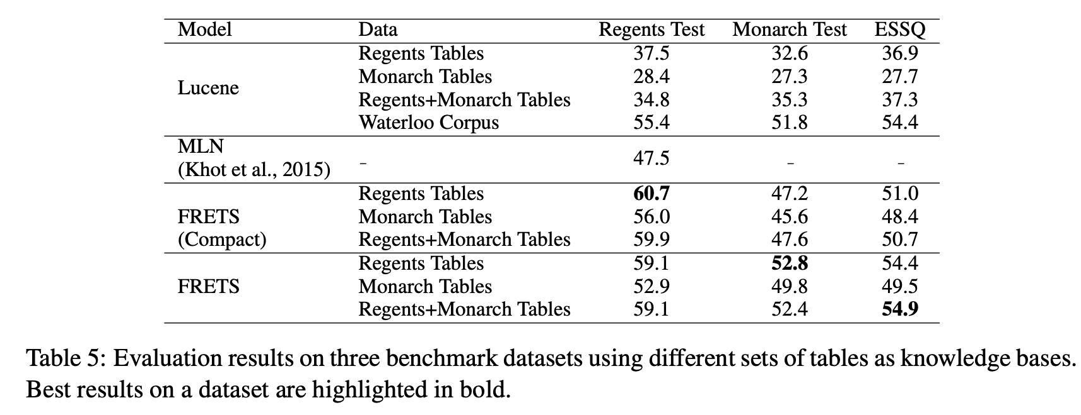
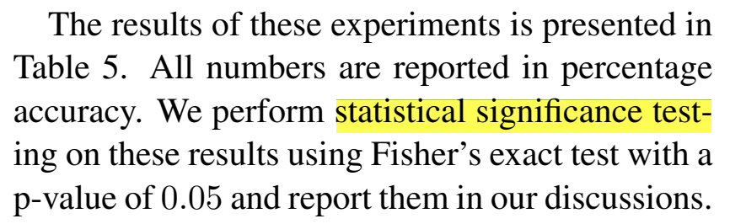
Omission of hypotheses
(EMNLP 2018)
?
Ⓐ >> Ⓑ
Statistical Tool
Hypothesis
Research Question
Flawed practice: Many works use hypothesis assessment tests without knowing/stating their hypothesis.
Notes:
Here is a real example of that: a screenshot from a paper public at EMNLP 2019
There is a table of results, just like what we had earlier
The research question is clear from the context
The text also mentions what statistical tool they use.
But what is their hypothesis or scientific claim their pursuing to assess? Unclear.
This is an example; in fact, this is a systemic flaw practice I the field. (read)
We as a community, systematically, under-report and mis-report.

Slide 14
Talk Summary & Statement
Motivated by several serious malpractices:
Under-reporting of hypotheses and how they address research questions.
Inability to interpret statistical tools or their results.
Lack of awareness about various alternatives; e.g., Bayesian assessment tools.
Research works should be explicit about:
(a) Their choice of hypothesis and,
(b) How selected statistical tool addresses this hypothesis.
Notes:
Overall, this work/presentation is motivated by the observation that there seems to be limited understanding about: (read)
The key tip we’re offering is that: (read)

Slide 15
Statistical tools in this work . . .
Frequentist
Bayesian
Binary/Categorical Decisions
Null-Hypothesis Significance Test
Bayes Factor
Uncertainty Estimations
Confidence Interval
Posterior Intervals
(Kruschke and Liddell, 2018)
Notes:
The statistical tools considered in the paper are the following four (read them)
The two tools on the left are based on frequentist statistics, while the ones on the right are based on Bayesian inference.
Two distinct interpretation of probabilities which has resulted in two different schools of thought about decision-making problems.
A complementary categorization of these tools is based on the nature of the results that they provide:
the ones on the top encourage binary decision making, while those on the bottom provide uncertainty around estimates.
For the sake of this presentation, to make the talk more focused, we’re going to focus on the red algorithms, but in our paper we cover all 4 of them.
NHST, because it’s the most popular choice
PI, because I believe it’s a useful alternative.

Slide 16

Survey of the NLP Community
A questionnaire containing general and specific questions about significance assessment tools
Sent it to over 400 researchers randomly selected from ACL’18 proceedings
~50 individuals responded
Notes:
And before getting into the nitty-gritty details of the techniques, let me tell you about a survey that we conducted among NLP researchers
Where we had (read)
As you’d imagine, not everyone was happy about being asked to fill out a survey; so sometimes we’d receive replies like this.

Slide 17
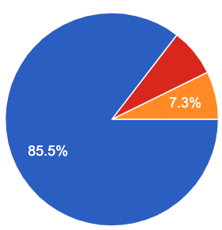
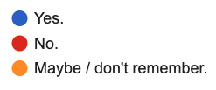
Survey of the NLP Community
“I have learned about statistical hypothesis testing/assessment (via taking classes or reading it from other places).”

Slide 18
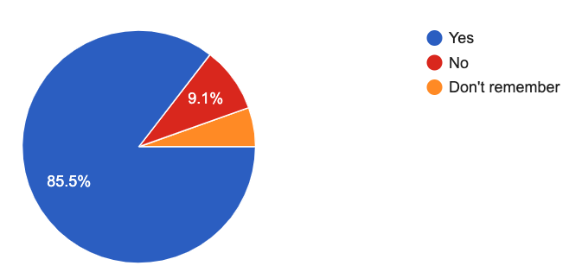
Participants in Our Survey
“I have used "hypothesis testing" in the past (in a homework, a paper, etc.)”

Slide 19
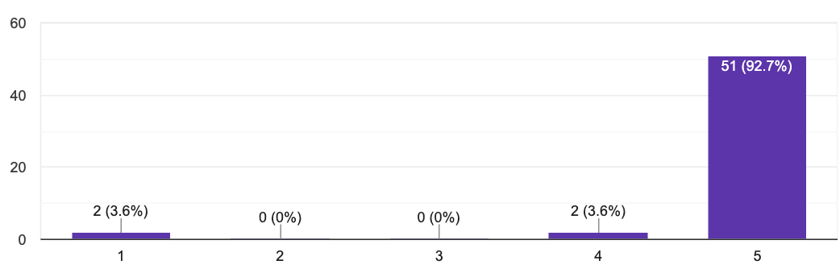
Participants in Our Survey
“I am not a robot”
Notes:
We included a question to check if people are paying attention to what they’re reading or not.
… turns out that 2 of our participants self-identified as robots.
And 2 people considered themselves partially a robot.
If people don’t laugh: just to make sure, this is not funny, or I am surrounded by a bunch of robots?

Slide 20
Trends and Patterns in the field
Study NLP conference papers: ACL’18 papers (439 papers)
How many papers did use significance testing?
Frequentist
Bayesian
The overuse of NHST is why we focus on its issues.
All techniques have their own limitations and ought to be used with this in mind.
73
0
Binary Decision
Null-Hypothesis Significance Test
Bayes Factor
Uncertainty Estimations
Confidence Interval
Posterior Intervals
6
0
Notes:
To better understand the common practices in the field, we went through ACL'18 papers and counted how many times each of these statistical assessment tools are used.
... which shows a heavy imbalance.
if at any point during this presentation you feel that I am bashing NHST and advocating from PR, is because this imbalance in their usage.
However, bear in mind that all techniques have their on limitations, and they all have to be used with this in mind.

Slide 21
Frequentist
Bayesian
Binary/Categorical Decisions
Null-Hypothesis Significance Test
Bayes Factor
Uncertainty Estimations
Confidence Interval
Posterior Intervals

Slide 22
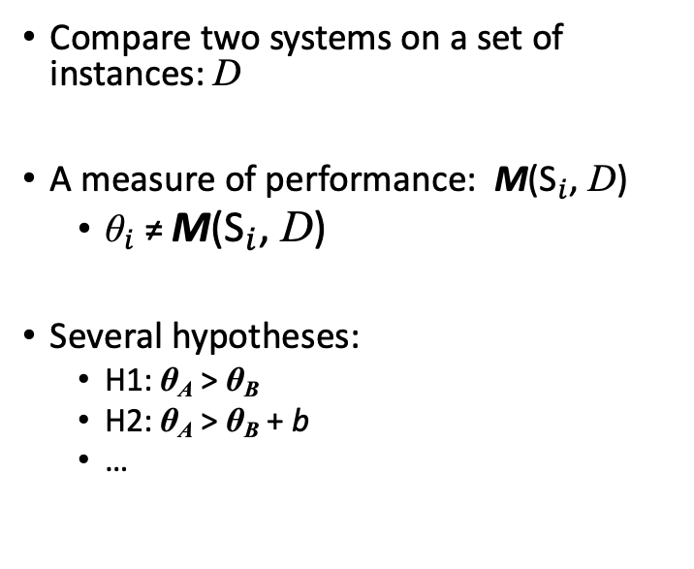
Notation
Input instances: D
Claims about the inherent properties θ_{A},θ_{B} of the two systems.
Compare two systems on a set of instances: D
A measure of performance: M(${\text{S}}_{i}$, D)
${\text{θ}}_{i}$≠ M(${\text{S}}_{i}$, D)
Several hypotheses:
H1: θ_{A} > θ_{B}
H2: θ_{A} > θ_{B} + b
…
SA
SA
Metric M
Hypotheses
Hypothesis Assessment
Observations
Conclusions validating
(or not) the hypotheses.
Notes:
Let’s fix our notation for the rest of the presentation:
Suppose we want to compare two systems on a dataset of instances D with respect to a measure M(S, x) representing the performance of system S on instances of our dataset.
In a typical NLP experiment, the goal is to infer some inherent and unknown properties of systems
We assume that each system Si has an unknown inherent accuracy value, denoted θi .
In this setup, one might, for instance, be interested in assessing the credibility of the hypothesis H that θ1 < θ2.

Slide 23
Null-Hypothesis Significance Testing
The goal is to decide whether the inverse of your claim can be rejected.
Make a hypothesis (that you want it to be rejected): null-hypothesis.
Assume that null-hypothesis is correct.
Calculate the probability of getting an outcome as “extreme” or more than the observed outcome.
This probability is called a “p-value.”
H₀: θ_{A} =θ_{B}
e.g., a bigger accuracy improvement.
(Søgaard et al., 2014; Koehn, 2004; Dror and Reichart, 2018)
Notes:
....
In this context, "extremeness" depends on the definition of your problem;
if you're comparing the accuracies of two systems, extremeness for example means increasing the accuracy of your system.
If you're adding a featuring to S2, you can define extremeness based on an estimate of monthly users.
And let's pick a name for this probability, since it's going to come up many times.

Slide 24
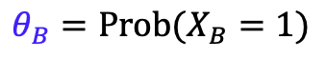
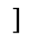
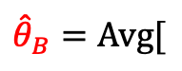
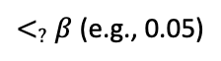
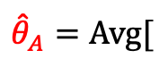
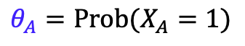
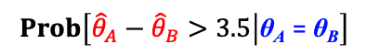
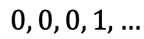
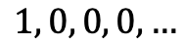

Null-Hypothesis Significance Testing: Example
Hypothesis H1: θ_{A} > θ_{B}
Null-Hypothesis H0: θ_{A} = θ_{B}
$$θ_{A}=Prob(X_{A}=1)$$
System | Accuracy
Ⓐ | 72.4%
Ⓑ | 68.9%
$${\hat{θ}}_{A}=Avg[$$
$$]$$
$$1, 0, 0, 0,…$$
$$θ_{B}=Prob(X_{B}=1)$$
$${\hat{θ}}_{B}=Avg[$$
$$0, 0, 0, 1,…$$
$$]$$
One-sided z-test
P-value=
$$Prob\left[{\hat{θ}}_{A}−{\hat{θ}}_{B}>3.5 | \text{θ}\text{A} \text{=} \text{θ}\text{B}\right]$$
$<_{?}$ $β$ (e.g., 0.05)
Notes:
...
Ya all this time you thought there are Transformers; but it was all a bunch of bored gineas (haha)
…. called z-test which is applicable to particular scenarios with some strict assumptions.

Slide 25
Interpreting p-values
Pretty complex notion!
“The probability of obtaining test results at least as extreme as the results actually observed during the test, assuming that the null-hypothesis is correct.” --your favorite statistics textbook
Notes:
Let's talk about interpreting p-values.
I personally struggled with this notion for years, and I thought it’s only me; until I heard from other people that it’s not just me.

Slide 26
Interpreting p-value
If p < 0.05, the null-hypothesis has only a 5% chance of being true
Remember that p-value is defined with the assumption that null-hypothesis is correct.
… but it does not tell anything about the likeliness of the null-hypothesis.
(Demsar, 2008; Goodman, 2008)

Slide 27
Interpreting p-value
A statistically significant result (p < 0.05) indicates a large/notable difference between two systems.
P-value only indicates strict superiority and provides no information about the margin of the effect.
(Demsar, 2008; Goodman, 2008)
Notes:
It’s false, by induction …
At least, the common tests.

Slide 28
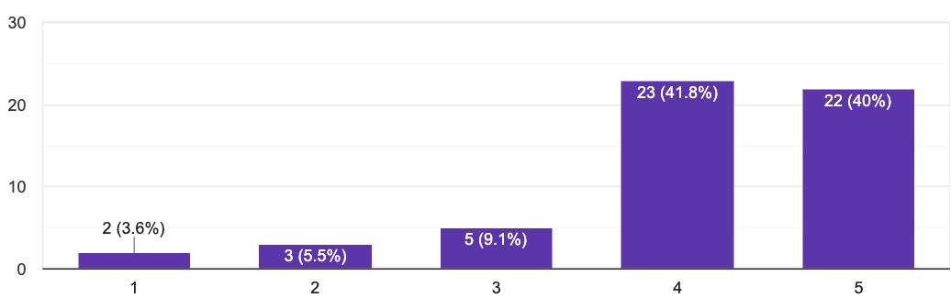
Participants in Our Survey
“I know p-values and I know how to interpret them.”

Slide 29
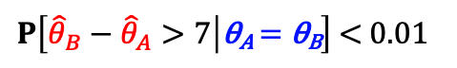
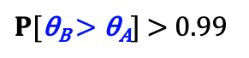
A Survey Question: Interpreting P-value
The authors claim that the improvement of classifier-B over classifier-A is “statistically significant” with a significance level of 0.01. Which of the followings is correct?
The probability of observing a margin 7% is at most 0.01, assuming that the two classifiers inherently have the same performance.
With a probability 99% classifier-2 will have a higher performance than classifier-1.
classifier-A | 38%
classifier-B | 45%
23%
$P\left[{\hat{θ}}_{B}−{\hat{θ}}_{A}>7 | \text{θ}\text{A} \text{=} \text{θ}\text{B}\right]$ < 0.01
30%
$P[\text{θ}\text{B} \text{>} \text{θ}\text{A}]$ > 0.99
🤦

Slide 30
Intermediate Summary
Null-Hypothesis Significance Tests are the most popular choice among NLP practitioners. Meanwhile, they’re difficult to understand and highly prone to misunderstanding.
P-values do not provide probability estimates on two classifiers being different (or equal).
Frequentist
Bayesian
Binary Decision
Null-Hypothesis Significance Test
Bayes Factor
Statistical significance is different than practical significance.
Uncertainty Estimations
Confidence Interval
Posterior Intervals
Notes:
Inherently, NHST is not designed to answer such queries about uncertainty of claims/hypotheses.

Slide 31
Frequentist
Bayesian
Binary/Categorical Decisions
Null-Hypothesis Significance Test
Bayes Factor
Uncertainty Estimations
Confidence Interval
Posterior Intervals

Slide 32
Posterior Intervals
Based on Bayesian inference framework.
(Thomas Bayes 1702-1761)
Notes:
This assessment tool is based on Bayesian Inference framework:
When I say inference, here is a rough description:
You receive an input (e.g., "fourcandles")
So you're confused; don't know what it means.
You want to infer: whether it was meant to be "four candles" or "fork handles"
And the key equation that will help us do this inference is the Bayes theorem.

Slide 33
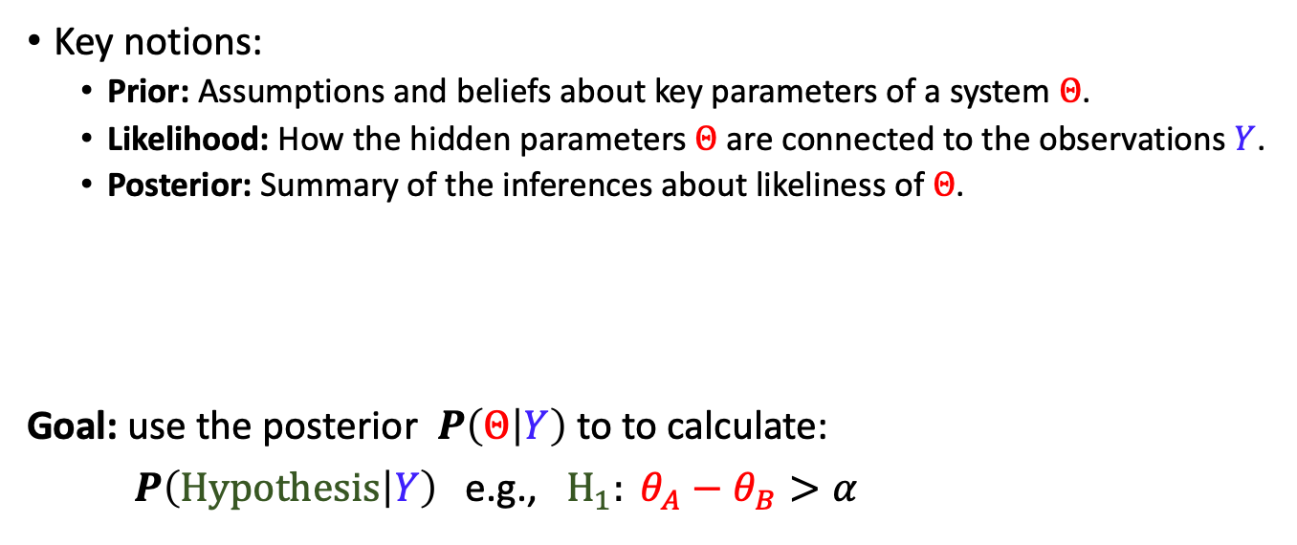
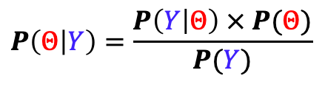
Posterior Intervals
Key notions:
Prior: Assumptions and beliefs about key parameters of a system $Θ$.
Likelihood: How the hidden parameters $Θ$ are connected to the observations $Y$.
Posterior: Summary of the inferences about likeliness of $Θ$.
Goal: use the posterior $P\left(Θ | Y\right)$to to calculate:
$P\left(Hypothesis | Y\right)$e.g., $H_{1}: θ_{A}−θ_{B}>α$
$$P\left(Θ | Y\right)=\frac{P\left(Y | Θ\right) × P(Θ)}{P(Y)}$$
Notes:
To refereshen your mind about the Bayes' theorem:
In Bayesian inference frameworks, the specification of a priori assumptions and beliefs are encoded in the form of a prior distribution P(θ) on parameters of the model.
a typical NLP experiment, these parameters can be, e.g., the actual mean or standard deviation for the performance of a system, as its inherent and unobserved property.
Likelihood function, formally models the underlying process that connects the latent parameters to the observations.
Consequently, a posterior distribution is inferred using the Bayes rule and conditioned on the observations.
The posterior distribution is a combined summary of the data and prior information, and states likeli values of θ.

Slide 34
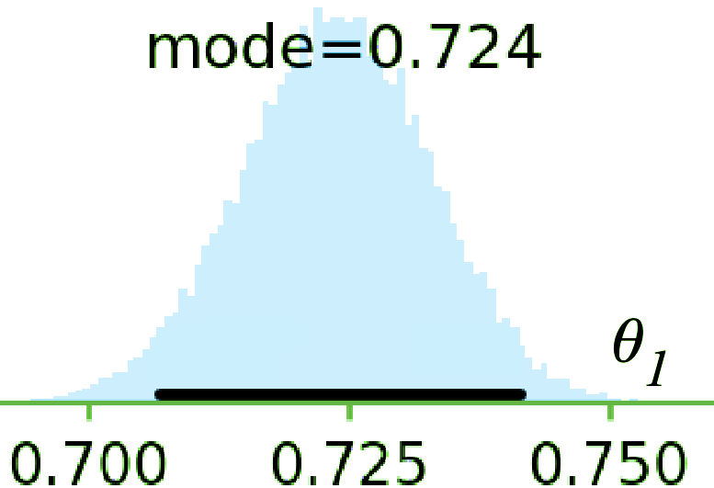
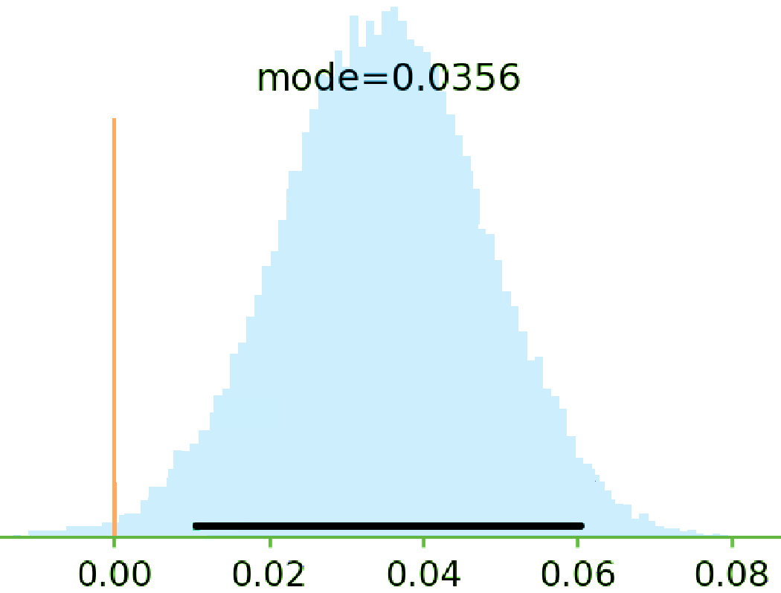
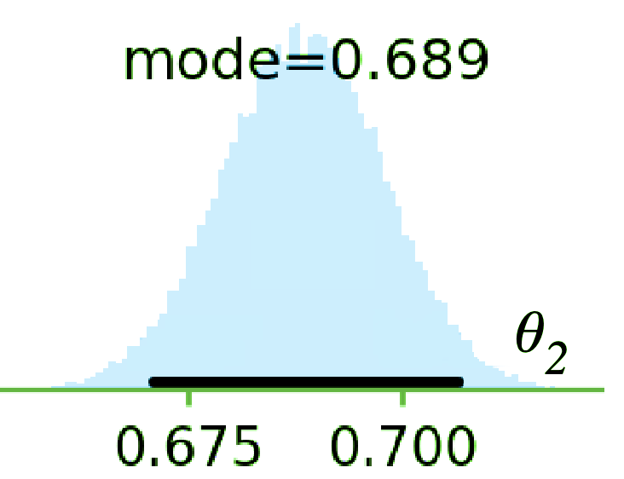
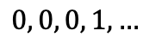
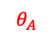
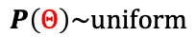
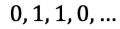
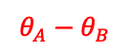
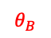
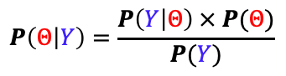
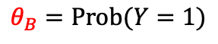
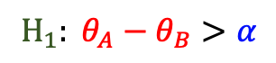
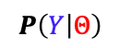
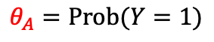
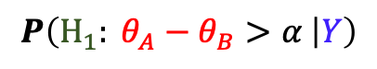
Posterior Intervals: Example
System | Accuracy
Ⓐ | 72.4
Ⓑ | 68.9
$$H_{1}: θ_{A}−θ_{B}>α$$
$$θ_{A}=Prob(Y=1)$$
Ⓐ
$$θ_{A}$$
$$0, 1, 1, 0,…$$
$$θ_{B}=Prob(Y=1)$$
Ⓑ
$$0, 0, 0, 1,…$$
$$θ_{B}$$
$$θ_{A}−θ_{B}$$
$$P\left(Y | Θ\right)$$
⊕
$$P\left(Θ | Y\right)=\frac{P\left(Y | Θ\right) × P(Θ)}{P(Y)}$$
$$P\left(H_{1}: θ_{A}−θ_{B}>α | Y\right)$$
$$P\left(Θ\right)\sim uniform$$

Slide 35
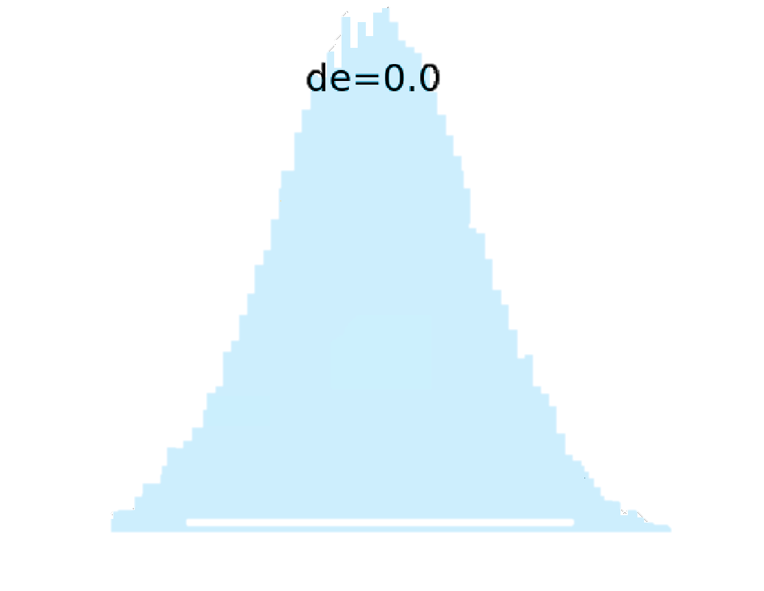
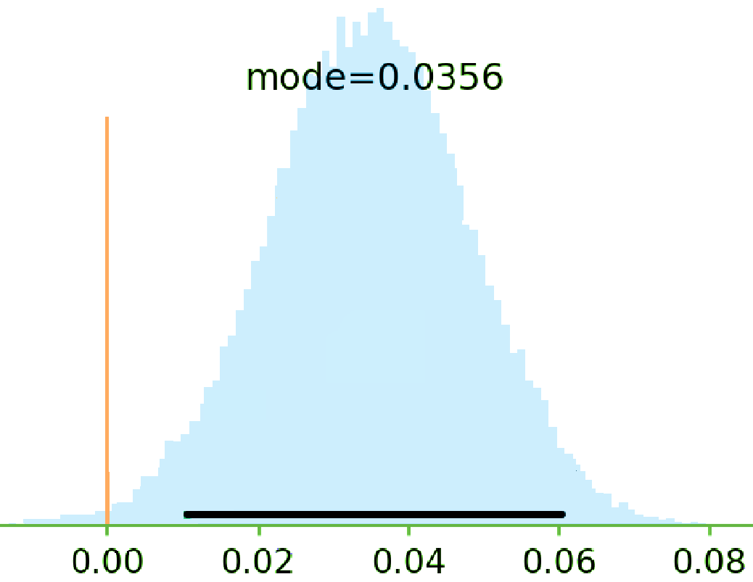
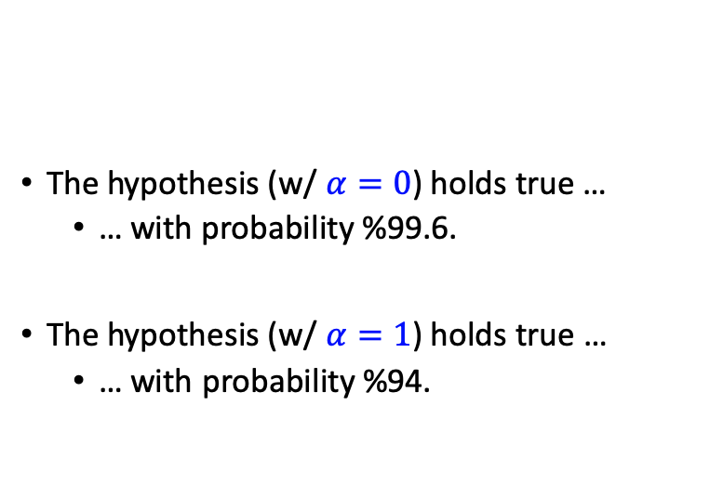
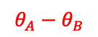
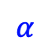
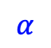
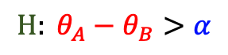
Posterior Intervals: Example
System | Accuracy
Ⓐ | 72.4
Ⓑ | 68.9
The hypothesis (w/ $α=0$) holds true …
… with probability %99.6.
The hypothesis (w/ $α=1$) holds true …
… with probability %94.
$$H: θ_{A}−θ_{B}>α$$
$$θ_{A}−θ_{B}$$
$$α$$
$$α$$
Notes:
One can read the following conclusion that: with a probability 0.99 the hypothesis (with x = 0) holds true.
This statement does not imply any difference with a notable margin.
with probability at least 0.94 the hypothesis (with x = 1) holds true.

Slide 36
2nd Intermediate Summary
Provides probability estimates over hypothesis of interest.
Easier to interpret → less ambiguous.
Provides a flexible framework
E.g., margin of superiority could incorporated in the definition of hypotheses.
This does not encourage binary decision-making.
Frequentist
Bayesian
Binary Decision
Null-Hypothesis Significance Test
Bayes Factor
Uncertainty Estimations
Confidence Interval
Posterior Intervals
Notes:
Let me try to summarize.

Slide 37
Measures of [Un]Certainty
P-values do not provide probability estimates on validity of hypotheses.
Posterior Intervals are interpretable in terms of post-data probabilities.
Frequentist
Bayesian
👎🏽
👎🏽
Binary Decision
Null-Hypothesis Significance Test
Bayes Factor
Uncertainty Estimations
Confidence Interval
Posterior Intervals
😑
👍🏽
(Goodman, 2008; Wasserstein et al., 2016)
Notes:
p-values do not provide probability estimates on the systems being different (or equal)
reporting posterior intervals generally provides the most useful summary as they provide uncertainty estimates.

Slide 38
Trends and Patterns in the field
Study NLP conference papers: ACL’18 papers (439 papers)
How many papers did use significance testing?
Frequentist
Bayesian
73
0
Binary Decision
Null-Hypothesis Significance Test
Bayes Factor
Uncertainty Estimations
Confidence Interval
Posterior Intervals
Why?
6
0
Notes:
Now let me go back to the study where we showed that the majority of the practitioners use NHST.
Now the question is what is the reason behind this imbalanced usage of the statistical tools;
Is this an informed decision to behave this way?
Or it is sth something else.

Slide 39
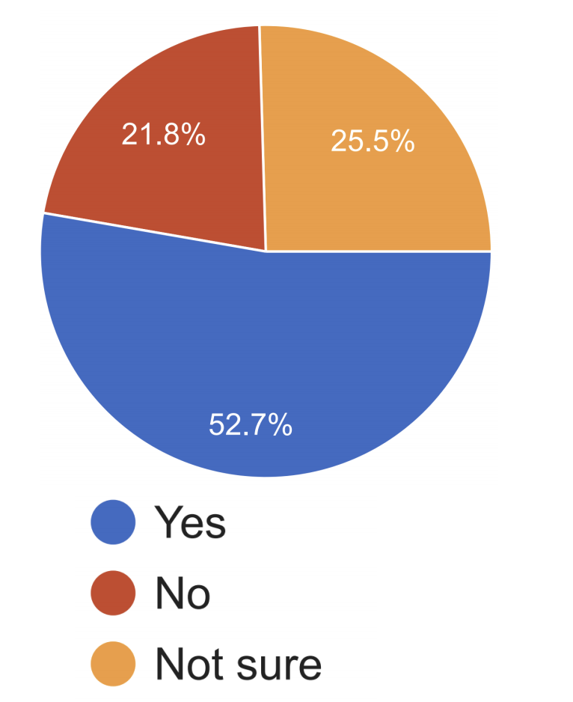
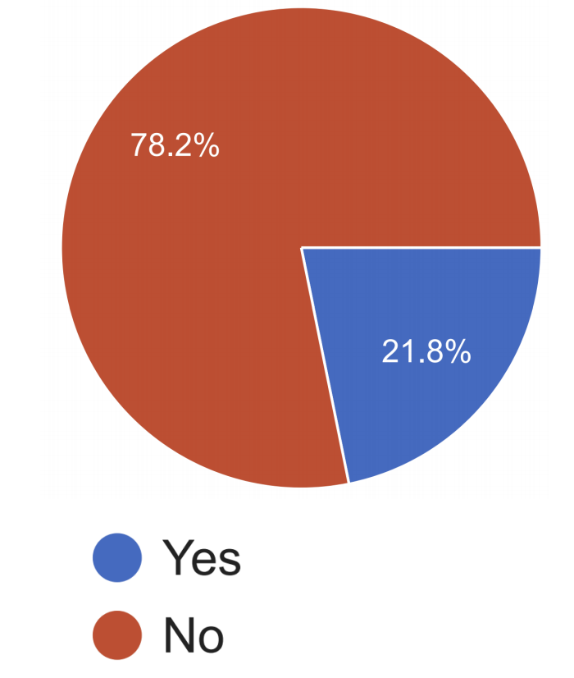
Have you heard about "Bayesian Hypothesis Testing"?
Do you know the definition of "Bayes Factor"?
Many people did not know the definition of “Bayes Factor” and some only had “heard” about them. 🤔
Notes:
The point here is that: maybe we have a lack of exposure problem in the field, possibly because these definitions are not included in their academic curiculum.

Slide 40
Final Section: Malpractices & Suggestions
Frequentist
Bayesian
Binary/Categorical Decisions
Null-Hypothesis Significance Test
Bayes Factor
Uncertainty Estimations
Confidence Interval
Posterior Intervals
Notes:
I am going to end the talk with several points about common mal practices and several suggestions.

Slide 41
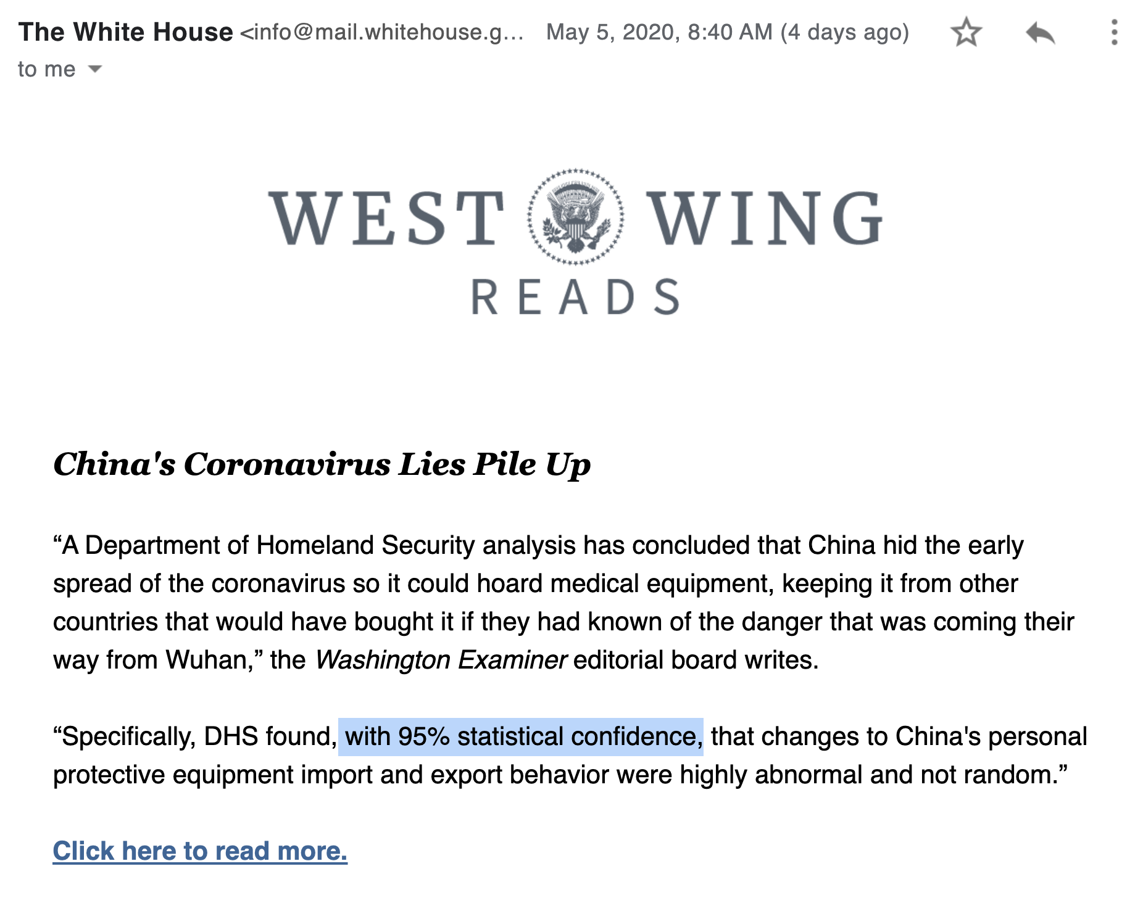
Ambiguous reporting
When referring to the results of significance testing, one should be mindful of how others are going to interpret it.
Notes:
Let me start by mentioning a non-NLP example.
A couple of days ago I received this newsletter email from the WH.
What grabbed my attention was that there is a mention of the statistical significance.
I don’t care what the claim is and whether it’s correct or not, but my issue is how the result of significance test is reported.
Now, if statement was in statistics textbooks, I’d be totally fine.
But if you’re, for example, you’re writing a report that is going to be read by general public, you should be super-careful how you’re going to

Slide 42
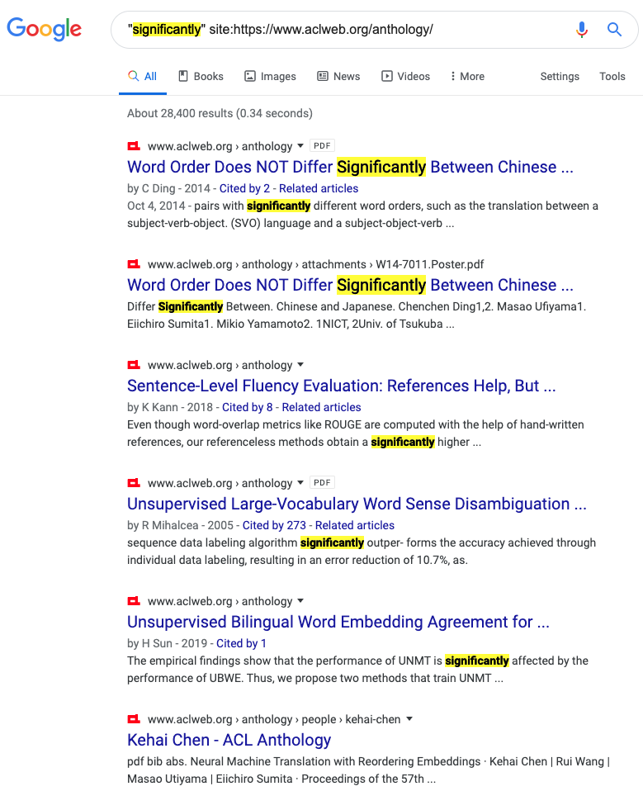
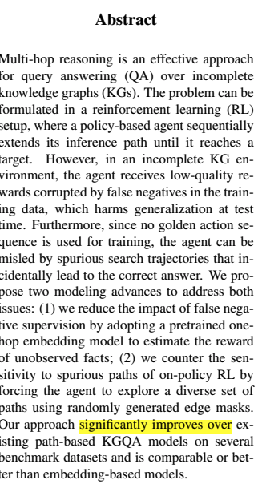
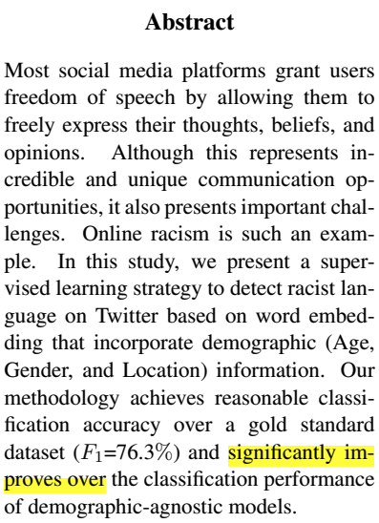
Ambiguity problem in interpreting “significance”
Notes:
When you search for the term “significantly” among the collection of published NLP papers, there are more than 28k papers.
And often such phrasings appear in key parts of papers like their abstracts. Here are two, for example.
But the main issue is the “ambiguity” problem in interpreting such phrases. In particular, it is not clear whether …

Slide 43
Ambiguity problem in interpreting “significance”
An NLP paper presents system-A and it compares it with a baseline system-B. In its “abstract” it writes: “... system-A significantly improves over system-B.” What are the right way(s) to interpret this (select all that applies)
It is expected that authors have performed some type of “hypothesis testing.”
It is expected that the authors have reported the performances of two systems on a dataset where system-A has a higher performance than system-B with a notable margin in the dataset.
83%
53%
Notes:
We wanted to verify this; so we included a question in our survey.
We asked out participants ….

Slide 44
The Usage of “Significance”: Our Recommendation
When referring to performing some type of “hypothesis testing,” use prefixes like “statistical”
When referring to big empirical improvements, use alternative terms like: “notable” or “remarkable.”

Slide 45
Tips and Suggestions
Frequentist
Bayesian
Binary Decision
Null-Hypothesis Significance Test
Bayes Factor
Define the research hypothesis you are after:
Uncertainty Estimations
Confidence Interval
Posterior Intervals
H1: Ⓐ and Ⓑ are inherently different, in the sense that if they were inherently identical, it would be highly unlikely to witness the observed 3.5% empirical gap.
H2: Ⓐ and Ⓑ are inherently different, since with probability at least 95%, the inherent accuracy of Ⓐ exceeds that of Ⓑ by at least 𝛼%.
…

Slide 46
Tips and Suggestions
The statements reporting p-value and confidence interval need to be precise.
… so that the results are not misinterpreted.
The term “significant” should be used with caution and clear purpose in order to not cause any misinterpretations.
better under a significance test != significantly better
One way to achieve this is by using adjectives “statistical” or “practical” before any (possibly inflected) usage of “significance.”

Slide 47
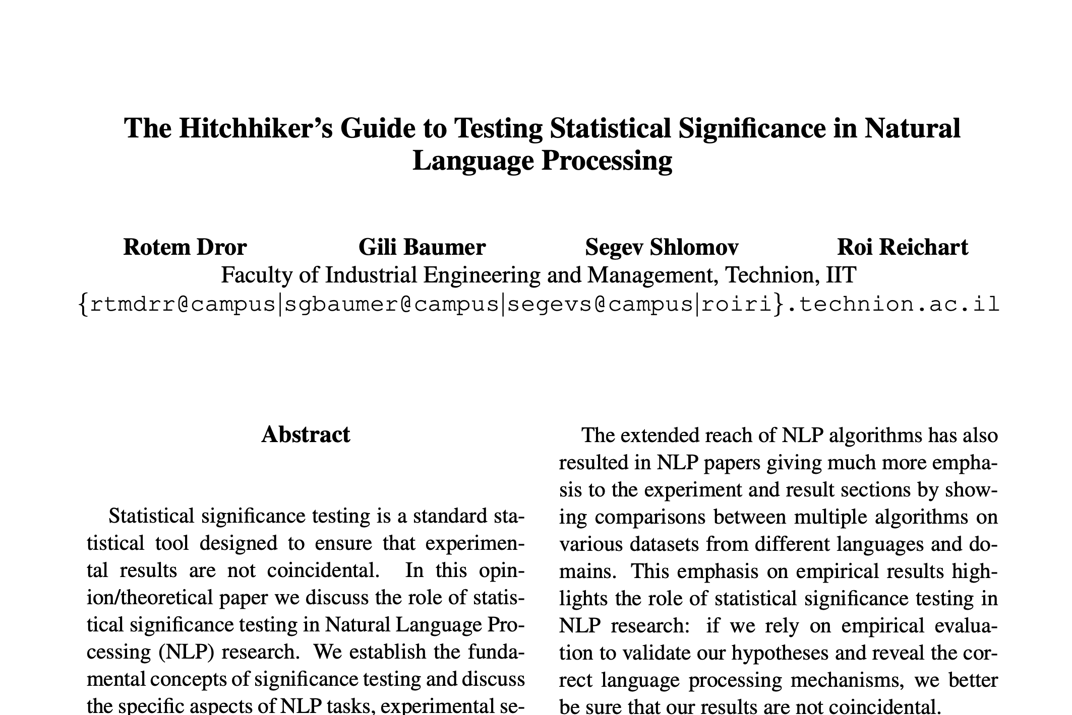
Tips and Suggestions
Frequentist
Bayesian
Binary Decision
Null-Hypothesis Significance Test
Bayes Factor
Uncertainty Estimations
Confidence Interval
Posterior Intervals
Lots of good tips about:
Selecting the right “test”
How to report your results.

Slide 48

Tips and Suggestions
If using Bayesian tests:
https://github.com/allenai/HyBayes/

Slide 49
That’s it!

Slide 50
The Need for Assumptions
Which tests have assumptions?
Assumptions are necessary to perform any statistical tests.
“no free lunch”
Many of them are questionable!
Frequentist
Bayesian
Binary Decision
Null-Hypothesis Significance Test
Bayes Factor
Uncertainty Estimations
Confidence Interval
Posterior Intervals
Notes:
All of them require assumptions
The key is to understand these assumptions and how these assumptions would affect the output of your conclusions.
All tests make assumptions, but each make different kind of assumptions.
This is to say that none of these tools are the gift of god; and their results could be false or misleading, depending on whether their assumptions are compatible with your setting or not.

Slide 51




Participants in our Survey

Slide 52

Participants in our Survey

Slide 53

Participants in Our Survey
“I can understand almost all the "statistical" terms I encounter in papers.”

Slide 54
Unintended Misleading Result by Iterative Testing
Reality
Expectation
Many tests are designed for a single-round experiment.
In practice researchers perform multiple rounds of experiments.
This is a major problem when using binary tests.
E.g., you can “hack” a p-value test, with enough repetitions.
Start
Start
???
End
Notes:
While many tests are designed for a single-round experiment, in practice researchers perform multiple rounds of experiments until a predetermined condition is satisfied. This is particularly a problem in binary tests (such as p-value) when the condition is to achieve a desired result. For example, a researcher could continue experimenting until they achieve a statistically significant result (even if they don’t necessarily have any intention of cheating the test) (Kim and Bang, 2016).
p-values encourage binary thinking (Gelman, 2013; Amrhein et al., 2017). A binary significance test, can not say anything about the relative merits of two hypotheses (the null and alternative) since it is calculated assuming that the null-hypotheses is true
Since the outcomes of p-values and CIs only can “reject” or stay “undecided”, these tests reinforce an unintentional bias towards the only possible decision. Consequently, it becomes easy to misuse this testing mechanism: for big enough data points it is possible to make statistically significant claims (Amrhein et al., 2017).

